Slide 1
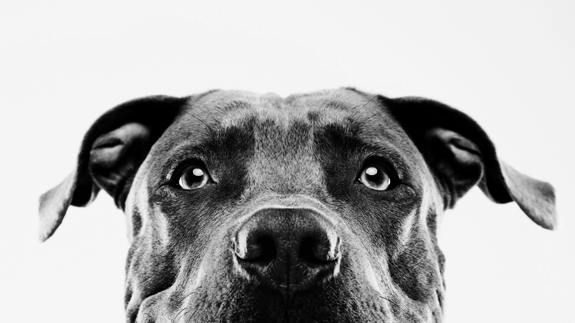
RESCUE my HOME
Increasing Adoption and Decreasing Suffering at the Austin Animal Center

Slide 2

Problem
Capacity Crunch.
But is it really that big a deal?

Slide 3

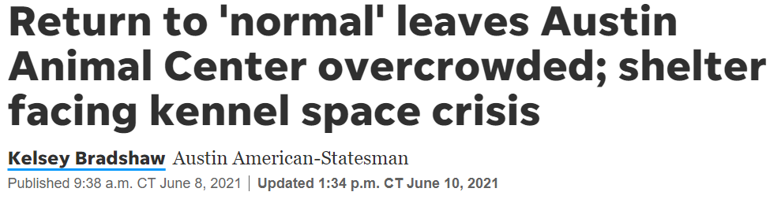
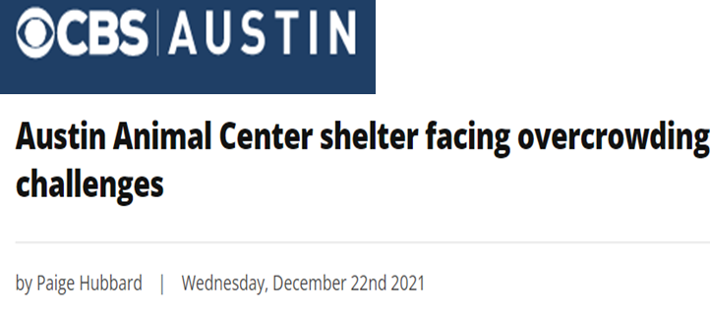
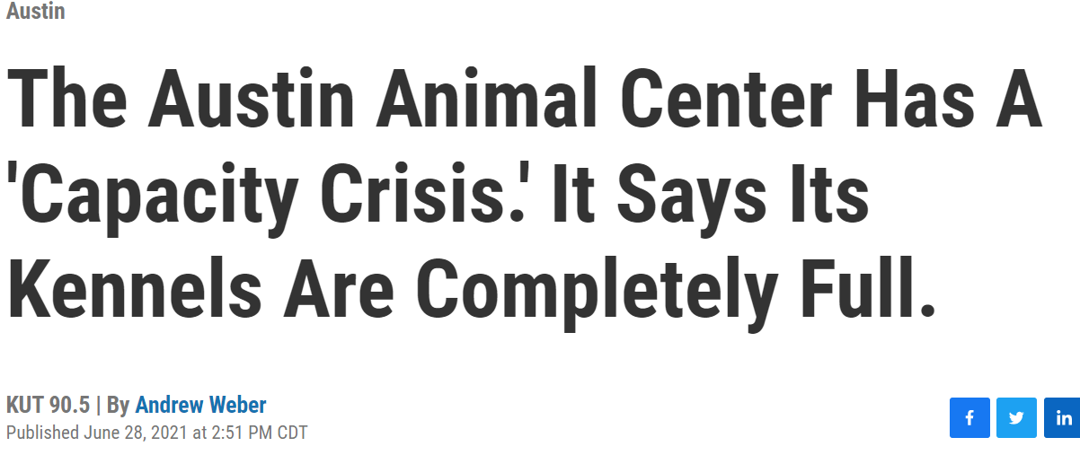
Big deal?
Capacity Crisis.

Slide 4

What are the causes?
Adoption Biases
Capacity Crunch
Inaccurate Intake Prediction
Negative Public Sentiment
Notes:
Intake Trend: COVID, Fall; Adoption Biases: Median Days to adopt, Dogs vs Cats – slides 7 and 8; Euthanasia
SPACIOUS/BETTER? → Increase Outcomes during Low Intakes + Reduce Biases around animal breeds and promote adoption + Predict animal intake trend to manage the space better + Making shelter’s rehabilitative
Adoption and Safety

Slide 5
Solution
Optimizing the space by promoting adoption and safety!

Slide 6
Data Description
Animal Intake and outcome data from the Texas Animal Shelter
Each animal is identified by a unique Animal ID in the Intake dataset. However there are some animals that re- enter the shelter (duplicated animal IDs)
In order to create a unique ID, we created a sequence number and added that to the Animal ID. Accordingly, each row in the intake dataset consists of a Intake event.
We Left joined the intake dataset with outcome dataset using the composite key of Animal ID and entry sequence number
Data Quality Issues
Incorrect intake Age (negative Age values)
Missing values on Sex upon intake,
Removed rows where the outcome was (Label)
Reporting Period: 2013-10-01 to 2022-04-18

Slide 7
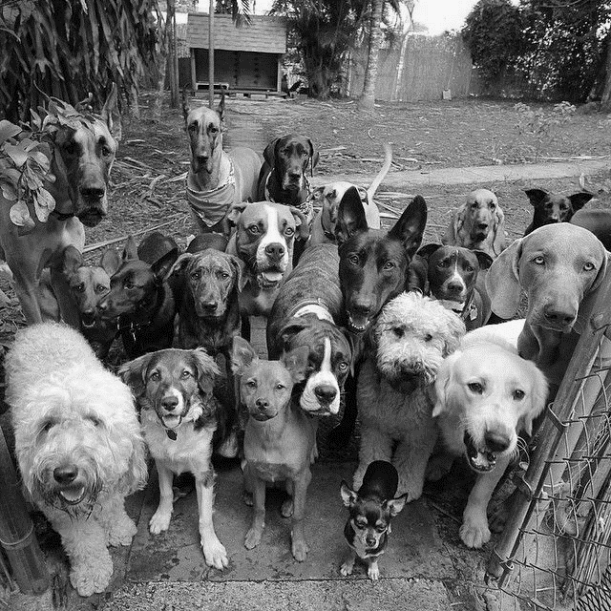
Intake Analysis: Managing Demand

Slide 8
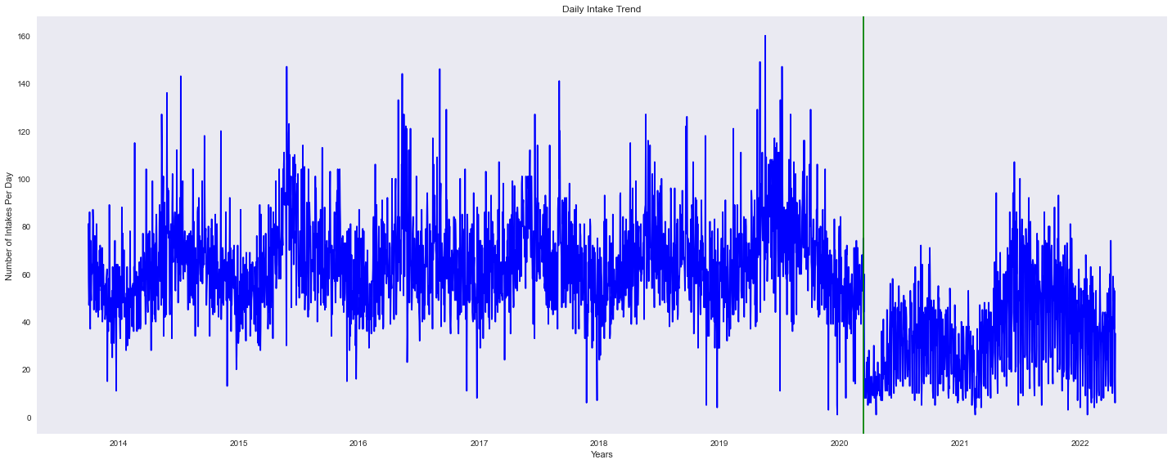
Daily Trends
Animal intake is dropped in March 2020. Unforeseen impact due to COVID.

Slide 9
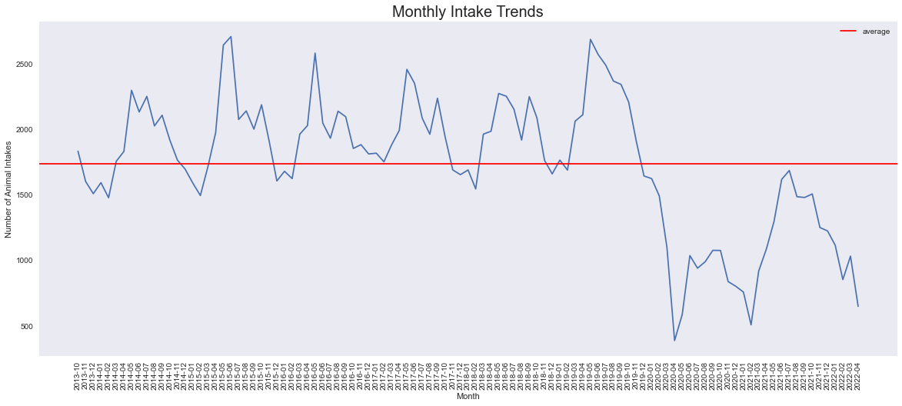
Monthly Trends
Each year, Intakes increase starting in March (Spring) and drop low around October (end-Fall).
Run adoption campaigns during October to March when the intake period is low.
This will ensure more space is made available before the next peak in March (Spring) begins.

Slide 10
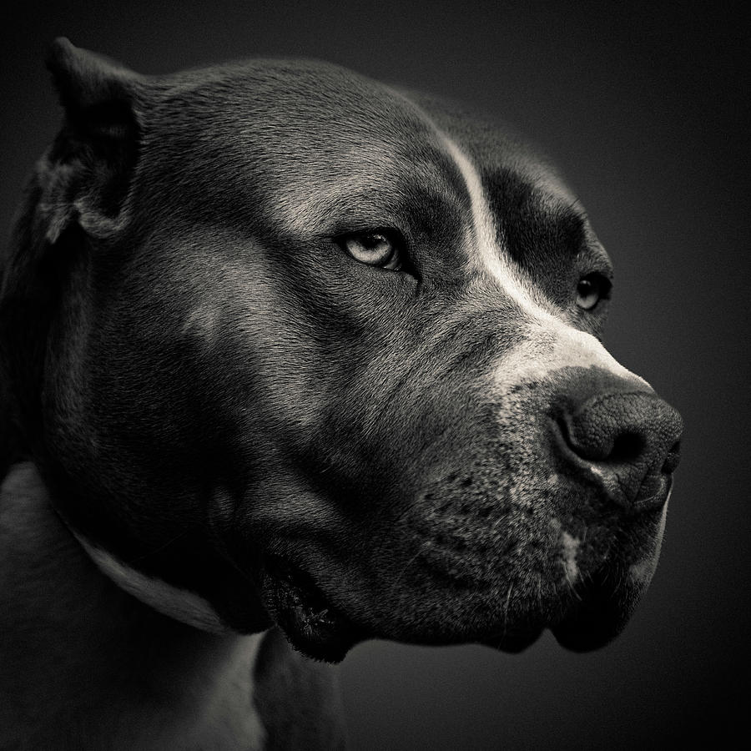
Adoption Analysis: Uncovering Biases

Slide 11
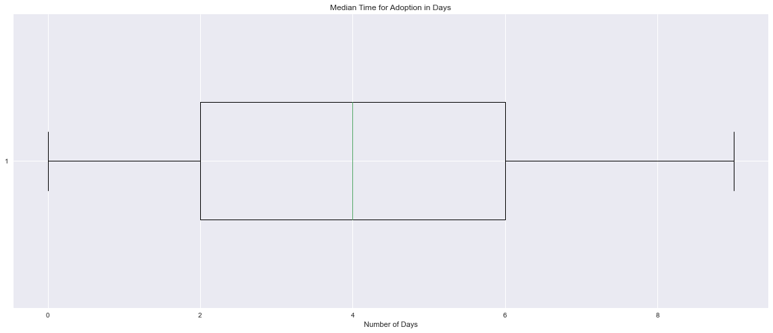
Median Time to Adopt (All Animals)
Median Time for Adoption = 4 days
Not all animals get adopted at the same time. Some wait for longer than others!
There are some animals that get adopted on the same day, and others that can take even upto 9 days.

Slide 12
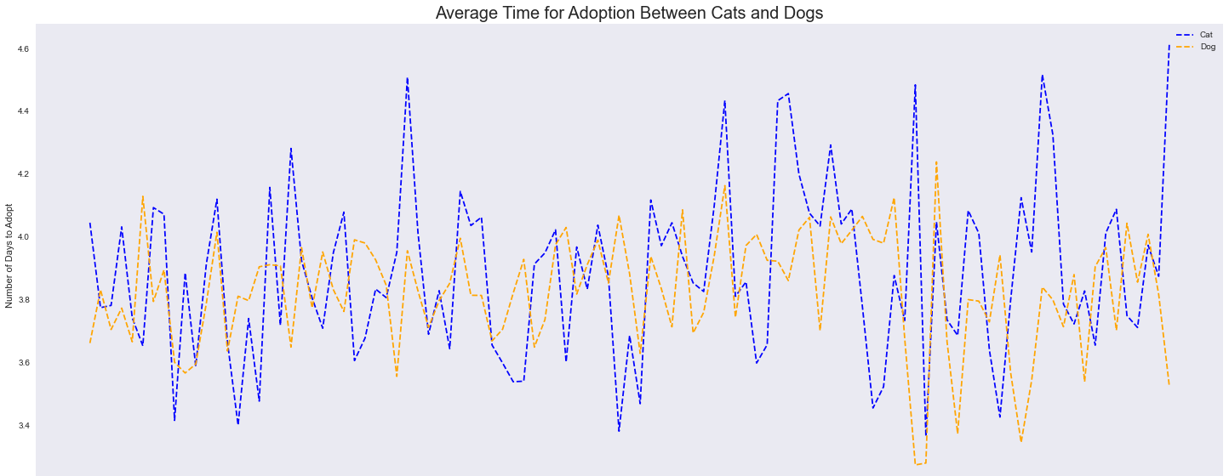
Dogs vs Cats: Is there favoritism in adoption?
Average Time for Adoption ➔ Dogs = Cats (approximately)
Cats have more variance (SD = 0.27) vs dogs (SD = 0.18)
However, this doesn’t tell us if one is more preferred than the other.

Slide 13
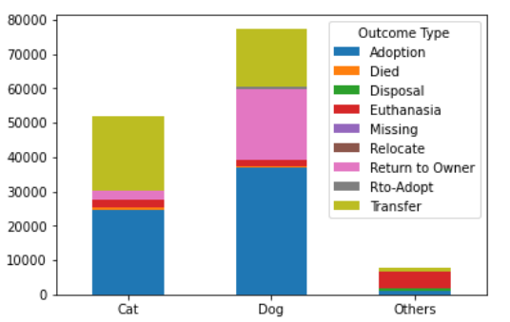
Dogs vs Cats: Is there favoritism in adoption?
Animal (Dog, Cat, Other) vs Outcome Type
Dogs have more number of adoptions and returns to owner than cats or other animal types.
Therefore, dogs can be concluded as more desirable than cats.

Slide 14
Are all dogs favorite?
Just because dogs are more preferred than cats, can we extend this desirability for all breeds?
Does a dog breed affect its desirability to find a home?

Slide 15
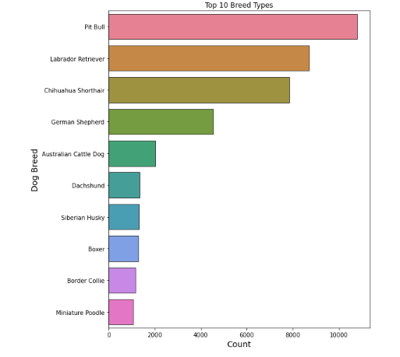
Popular Dog Breeds in Shelter
We can see that Pitbull and its mixed/cross breeds are the most common breed with a definite outcome from the shelter

Slide 16
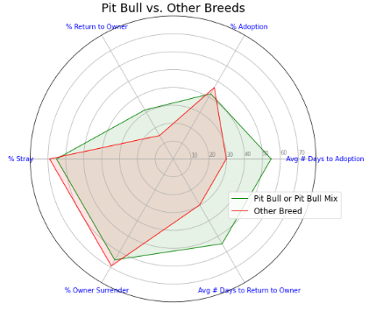
Desirability of a Breed: Pitbull
We can see a few interesting insights from the above chart -
% Owner Surrender is Low as compared to other breeds - This implies that Pitbull's are less likely to be surrendered by their owner, indicating to their desirability
% Return to Owner is Very High as compared to other breeds - This could be because Pitbull's are loved by their owners and develop a sense of attachment that makes about 31% of the Pitbull's return to their owners (though, the owners take time to realize that they are missing their dog (high avg. number of days to return). Yet another indication for desirability.
% Stray is Low as compared to other breeds - Since Pitbulls are predominantly domestic breeds, pitbulls are lesser often stray than other breeds.
Across other metrics, we can observe that Pitbulls have a slightly lower percentage of adoption and once in the shelter, it takes a long time for a Pit Bull to find home, thus making it less desirable perhaps due to its belligerent image, while known to being a loyal/attached pet.
Austin Animal Shelter should promote adoption of Pitbulls and use data to challenge the biases and stereotypes against such breeds.
This will help ease some pressure off the capacity.

Slide 17
Are all dogs favorite?
Just because dogs are more preferred than cats, can we extend this desirability for all breeds?
Does a dog breed affect its desirability to find a home?
Yes.

Slide 18
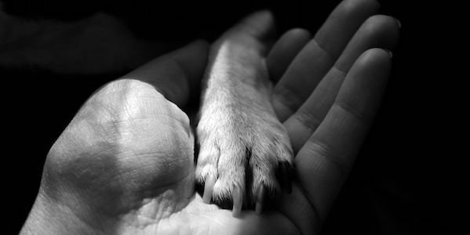
Safety Analysis: Avoiding Euthanasia

Slide 19

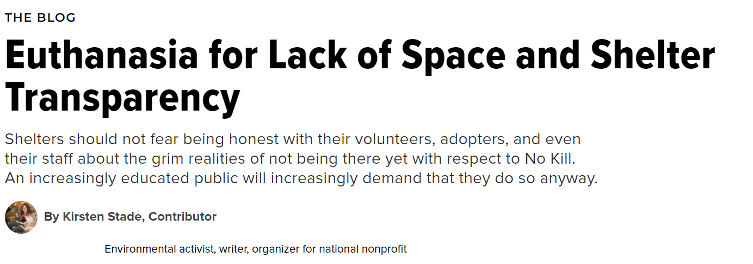
Euthanasia and Public Sentiment
Community outrage, organizations like PETA, and animal rights wings have minimized the number of euthanized animals per year. However, more can be done.

Slide 20
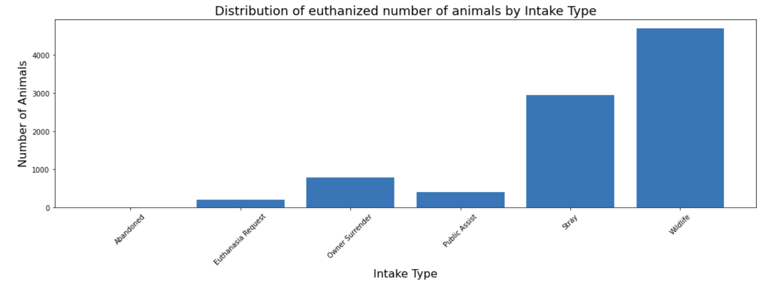
Euthanized Animals vs Intake Type
Euthanized Animals vs Intake Type
Total Euthanasia = 6.5%
Out of the Euthanasia Requests, 78% ended up getting euthanized

Slide 21
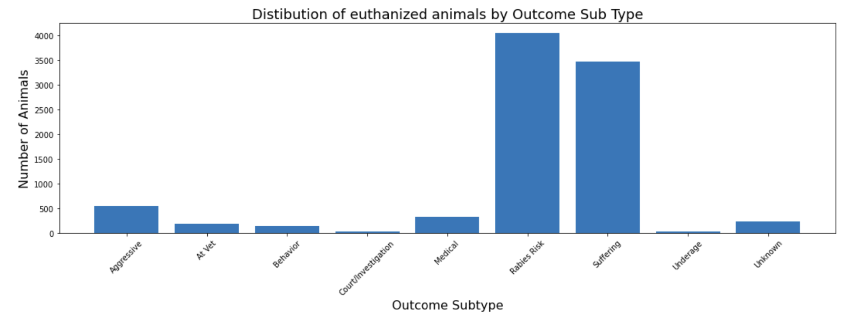
Euthanized Animals vs Outcome Type
Euthanized Animals vs Intake Type
Rabies Risk and Suffering are the popular causes behind euthanasia.
However, ~600 animals got euthanized with a “aggressive” or “behavior” as a cause for euthanasia.
Austin Animal Center can work to reduce this number and thus improve the public sentiment towards their no-kill animal shelter.

Slide 22
Recommendations Summary

Slide 23
Thank you!

